Slide 1
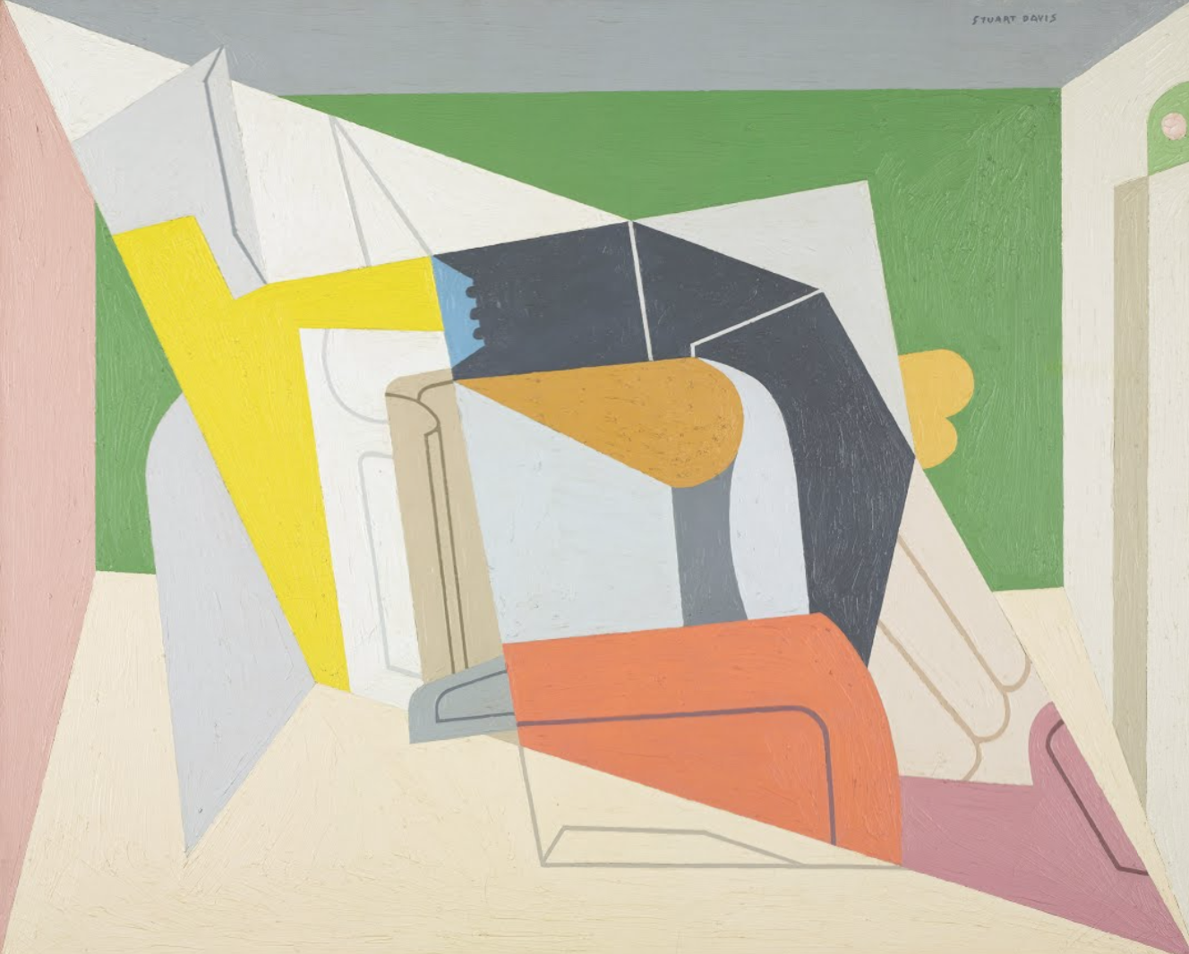
A Topological Analysis of Art Movements

Slide 2
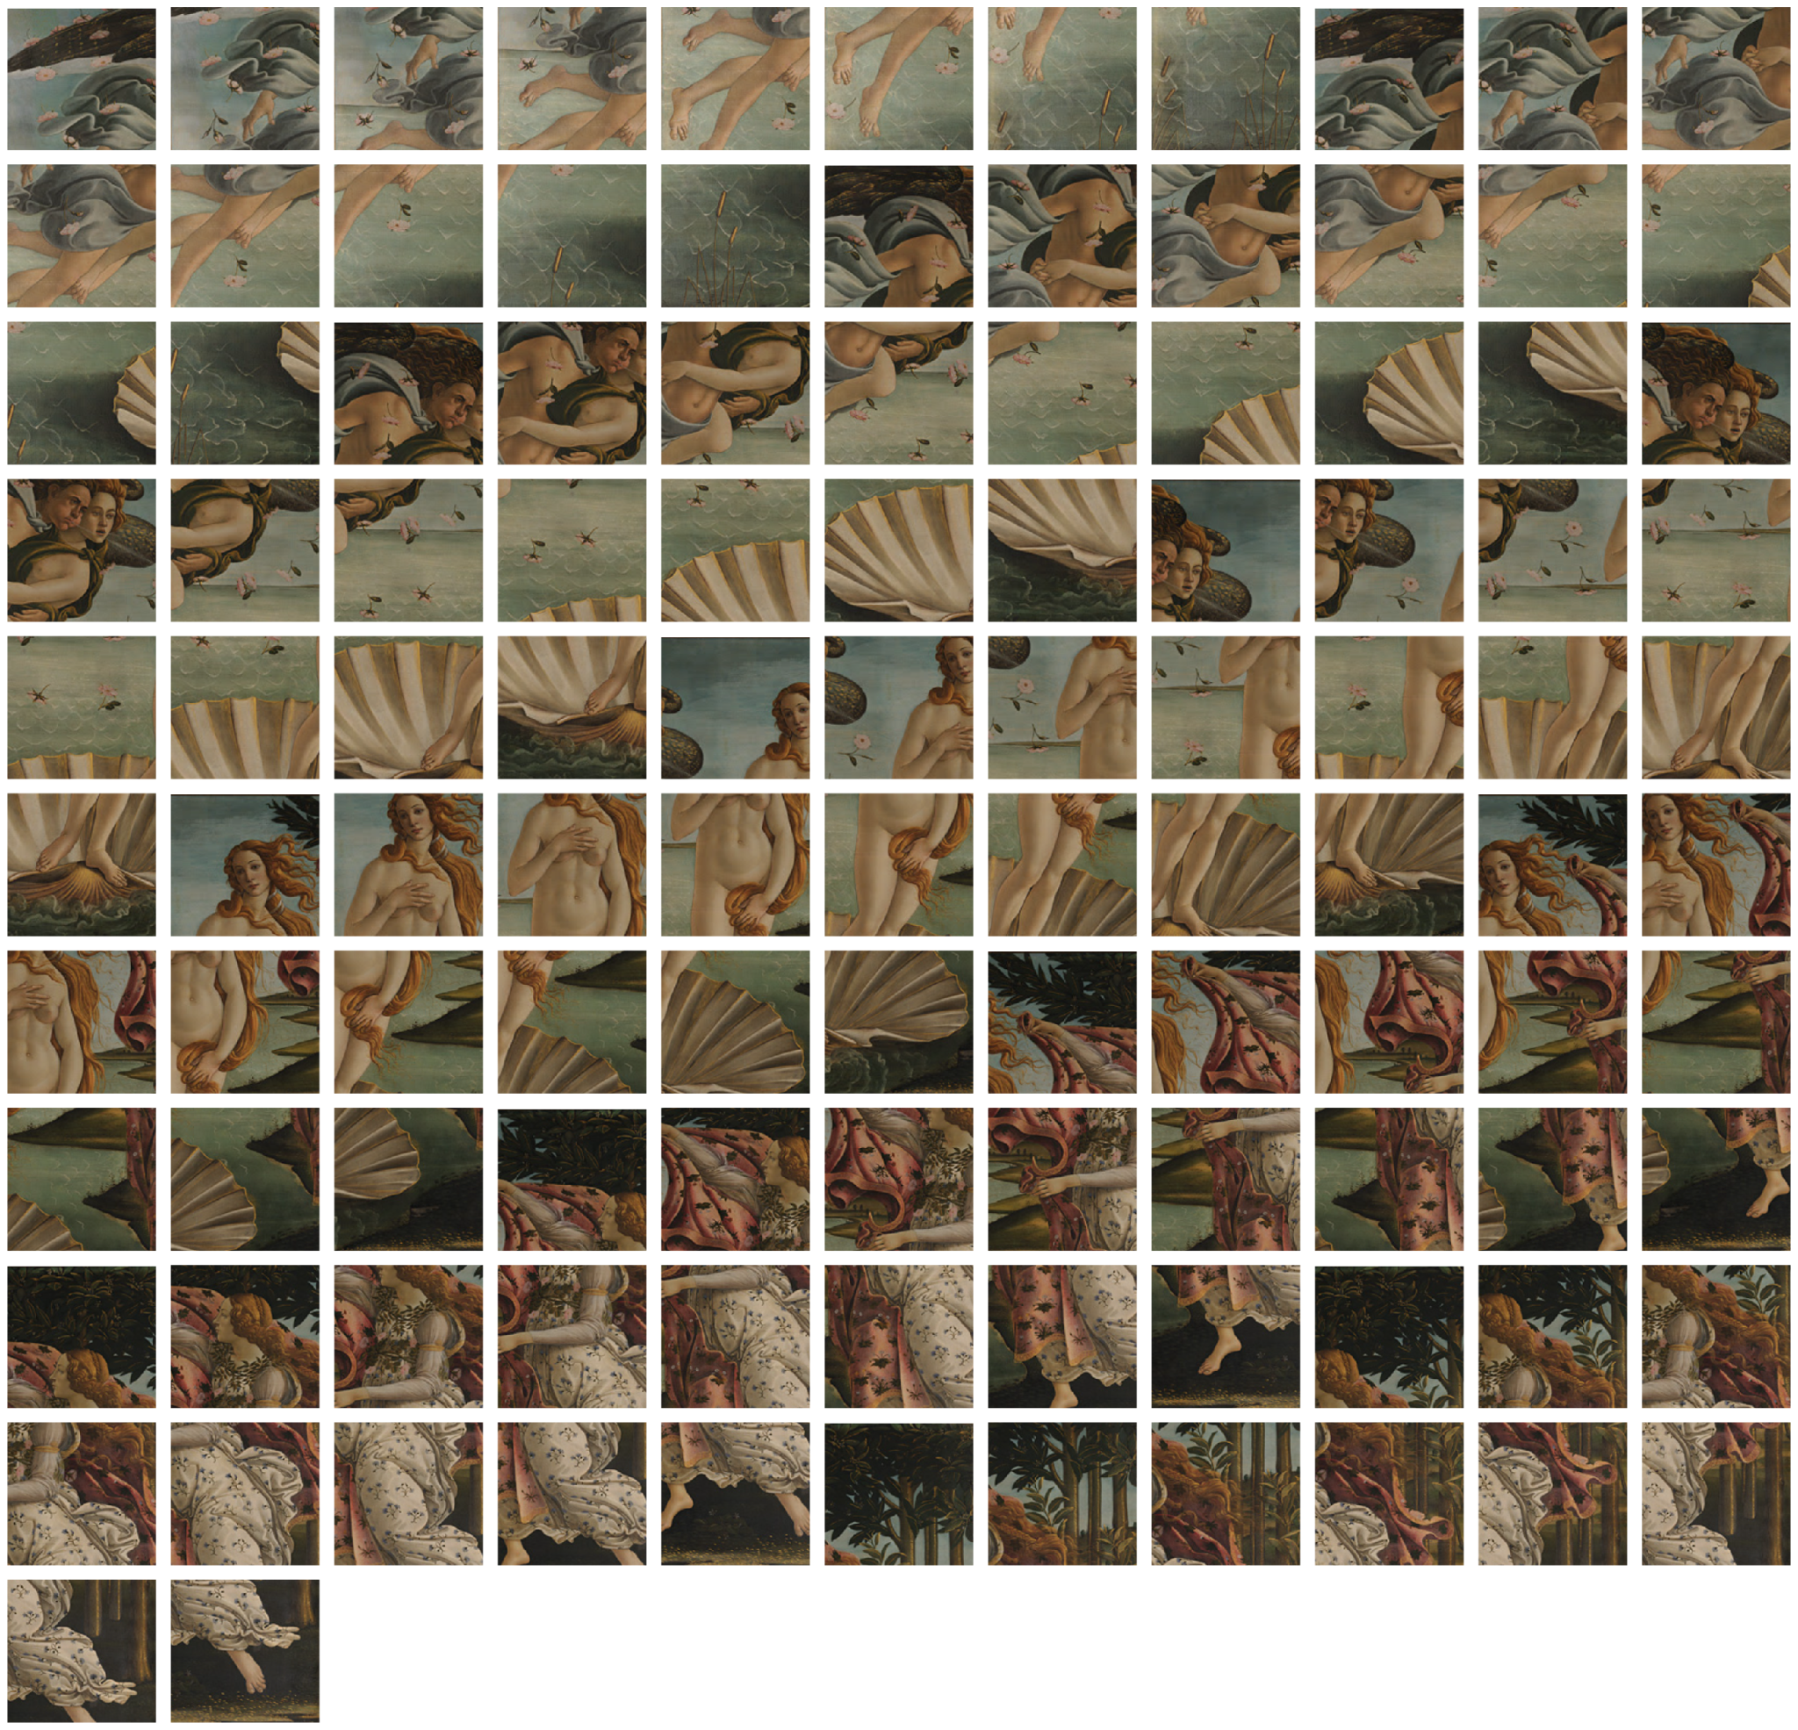
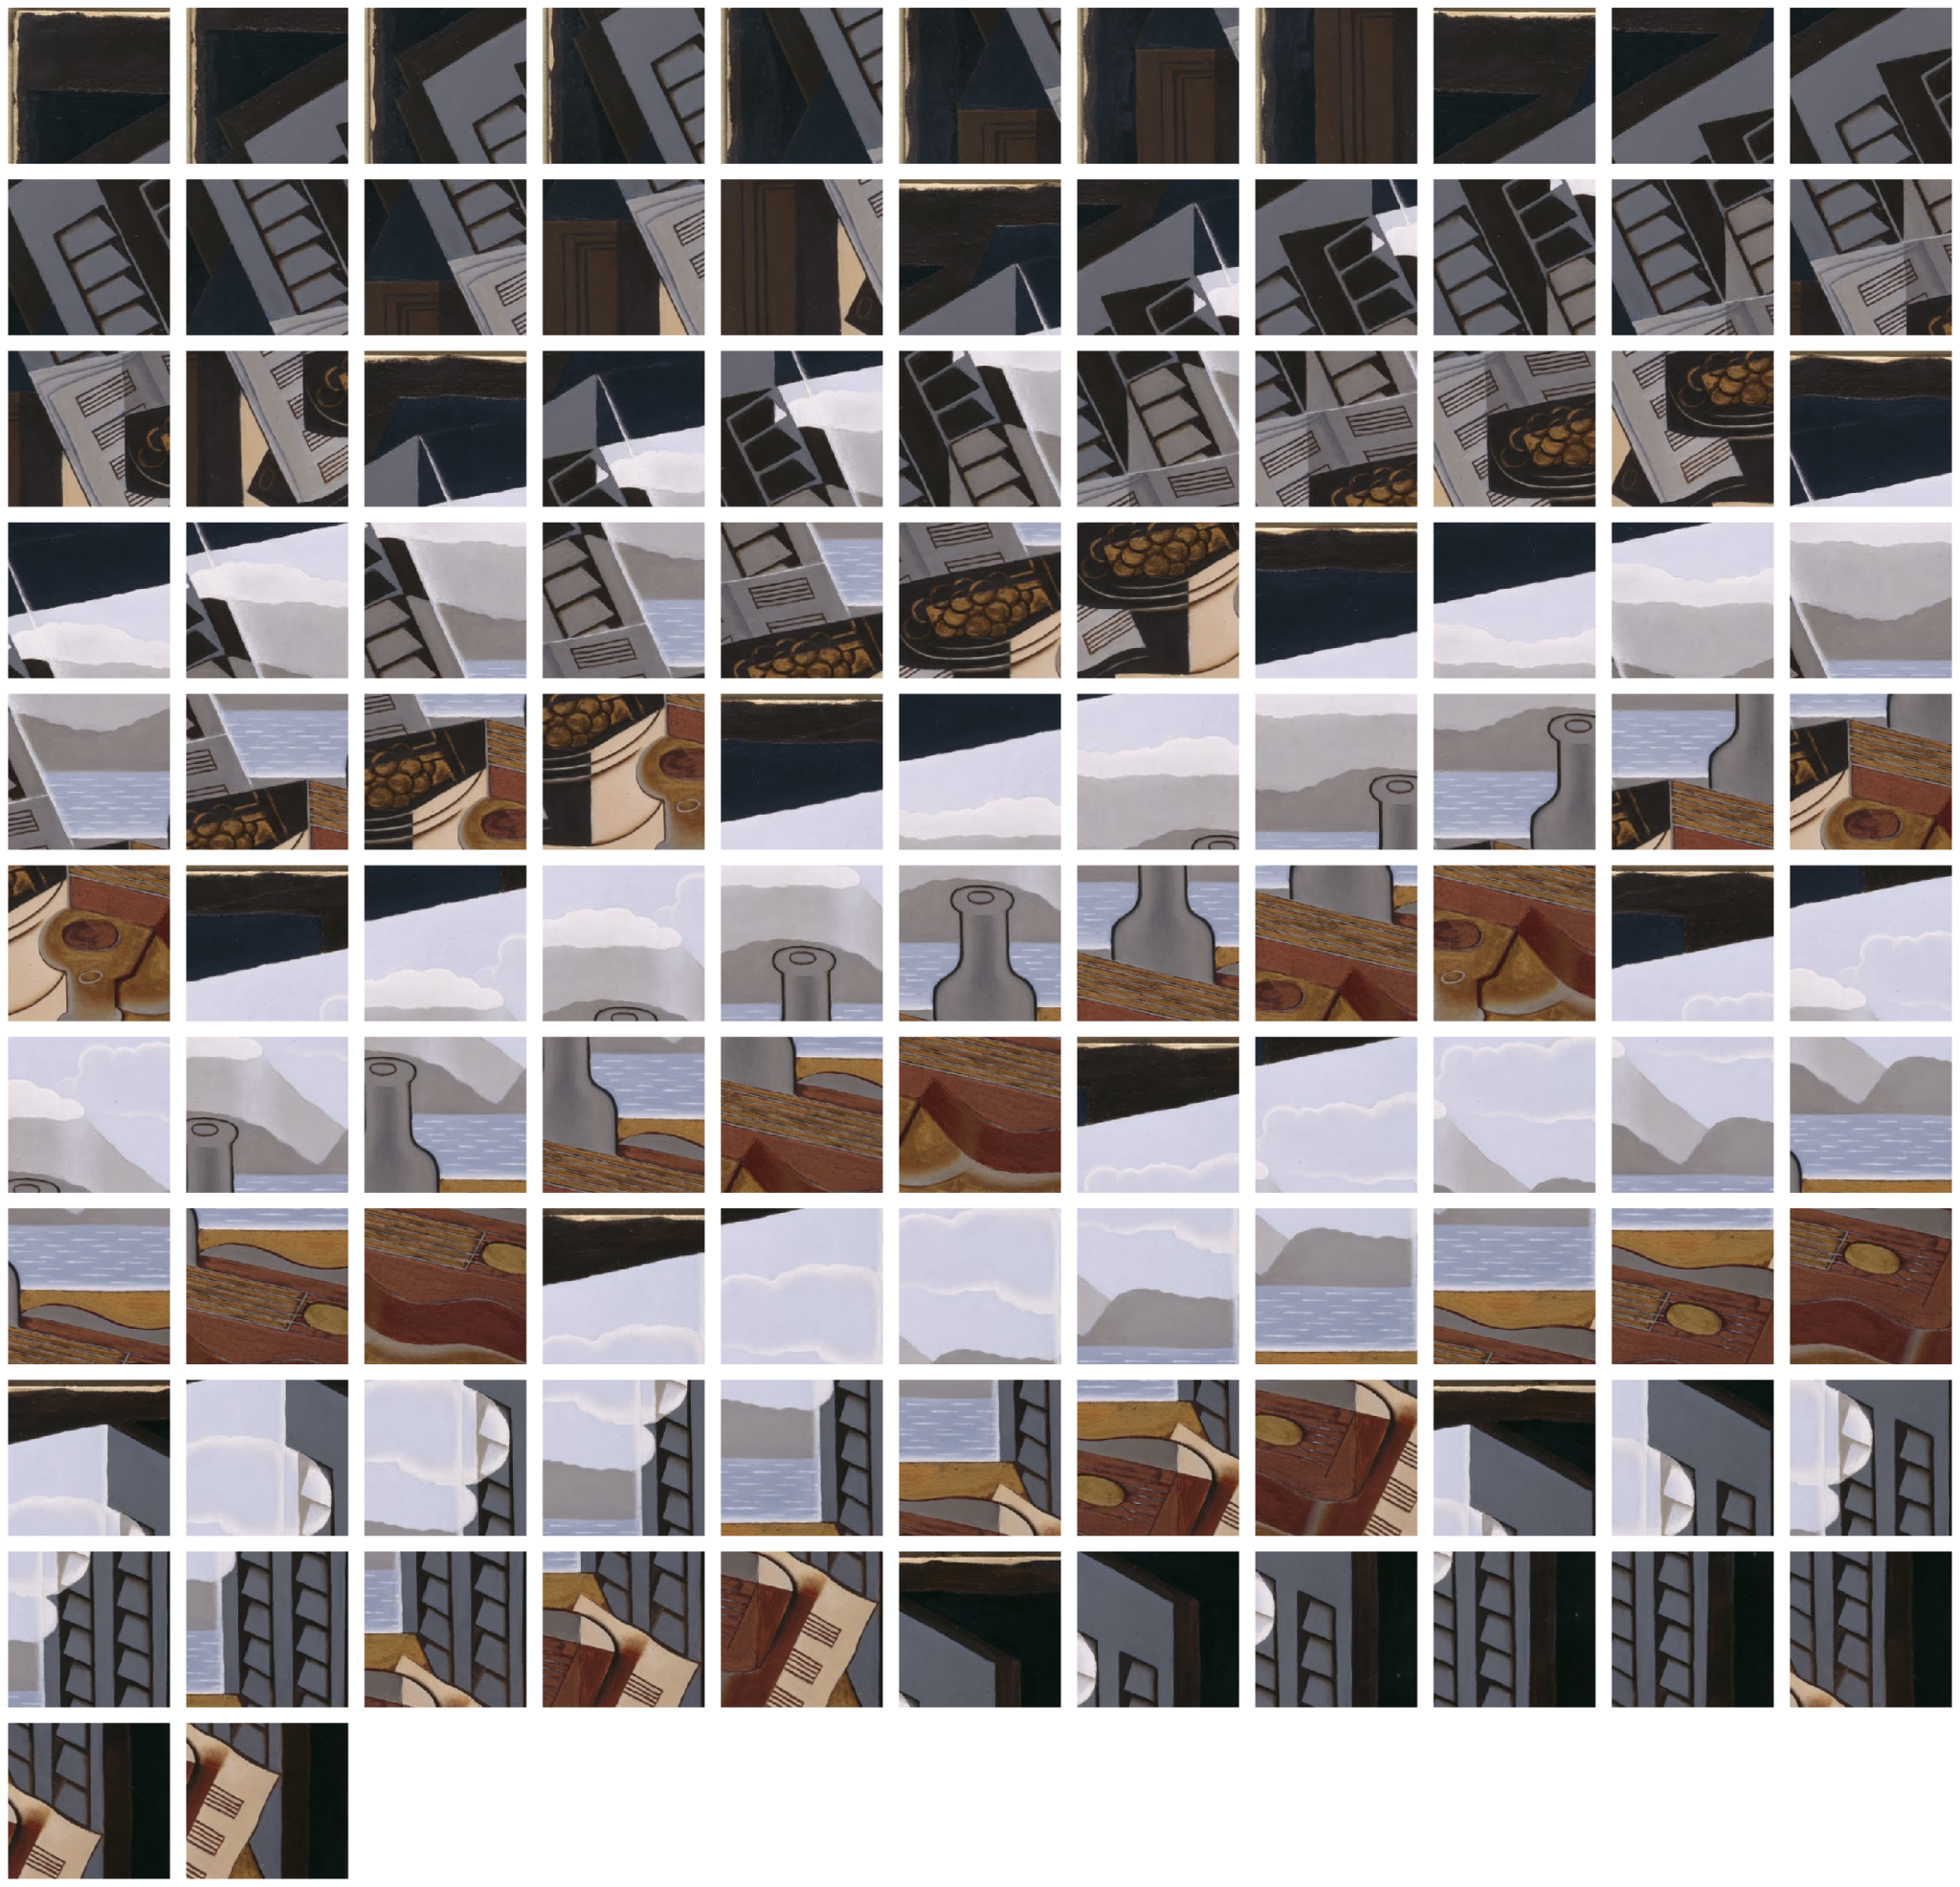
Data
Sample of 10 Cubist images and 10 Renaissance images (source Google Arts and Culture app)
Processed into a grid of overlapping patches (each patch 256 x 256 pixels)

Slide 3
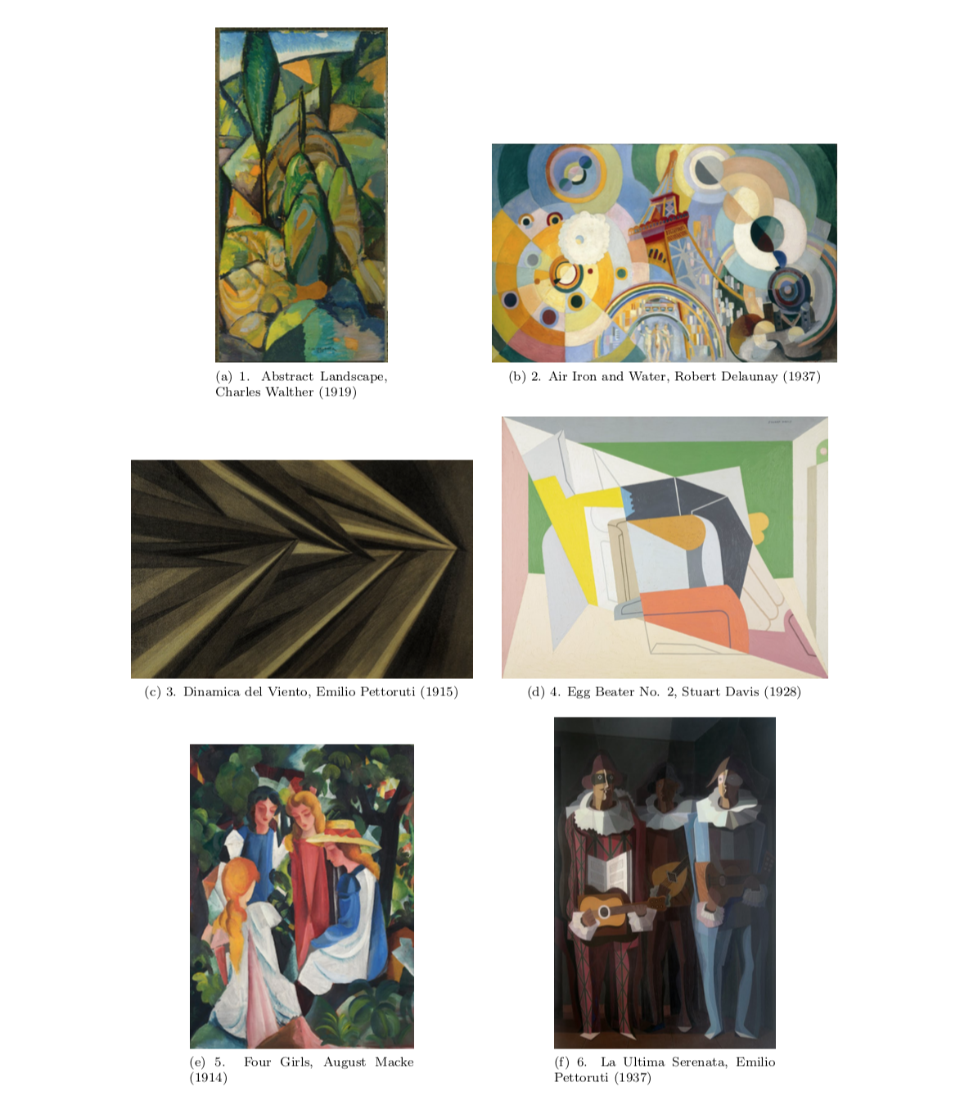
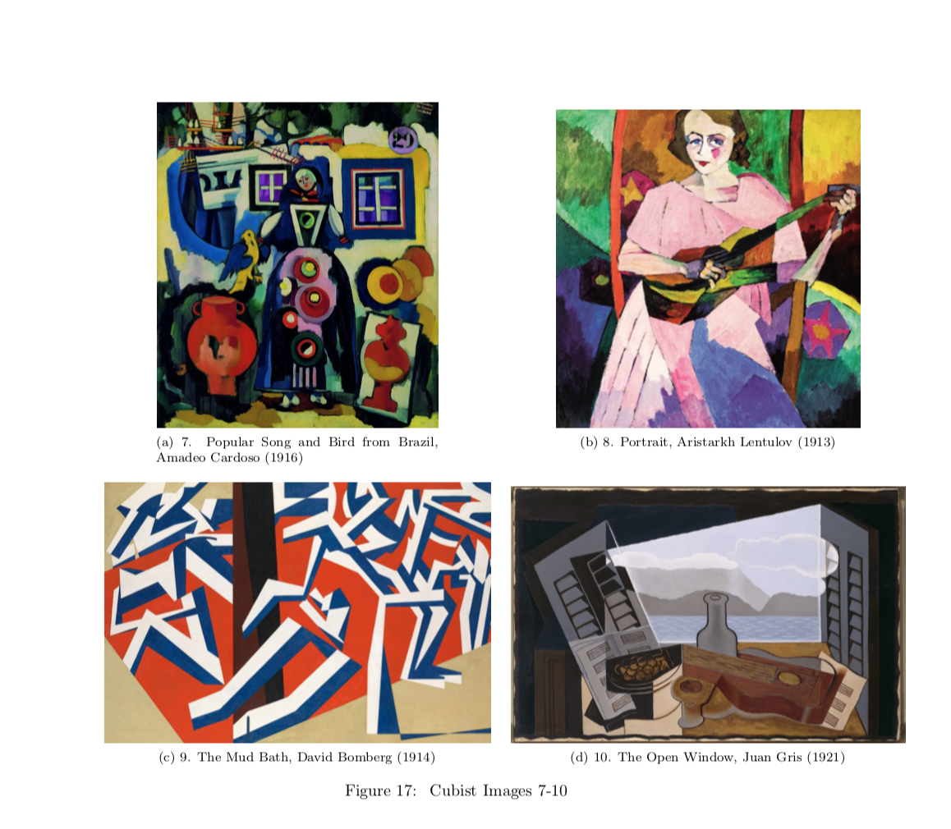
Cubist Paintings

Slide 4
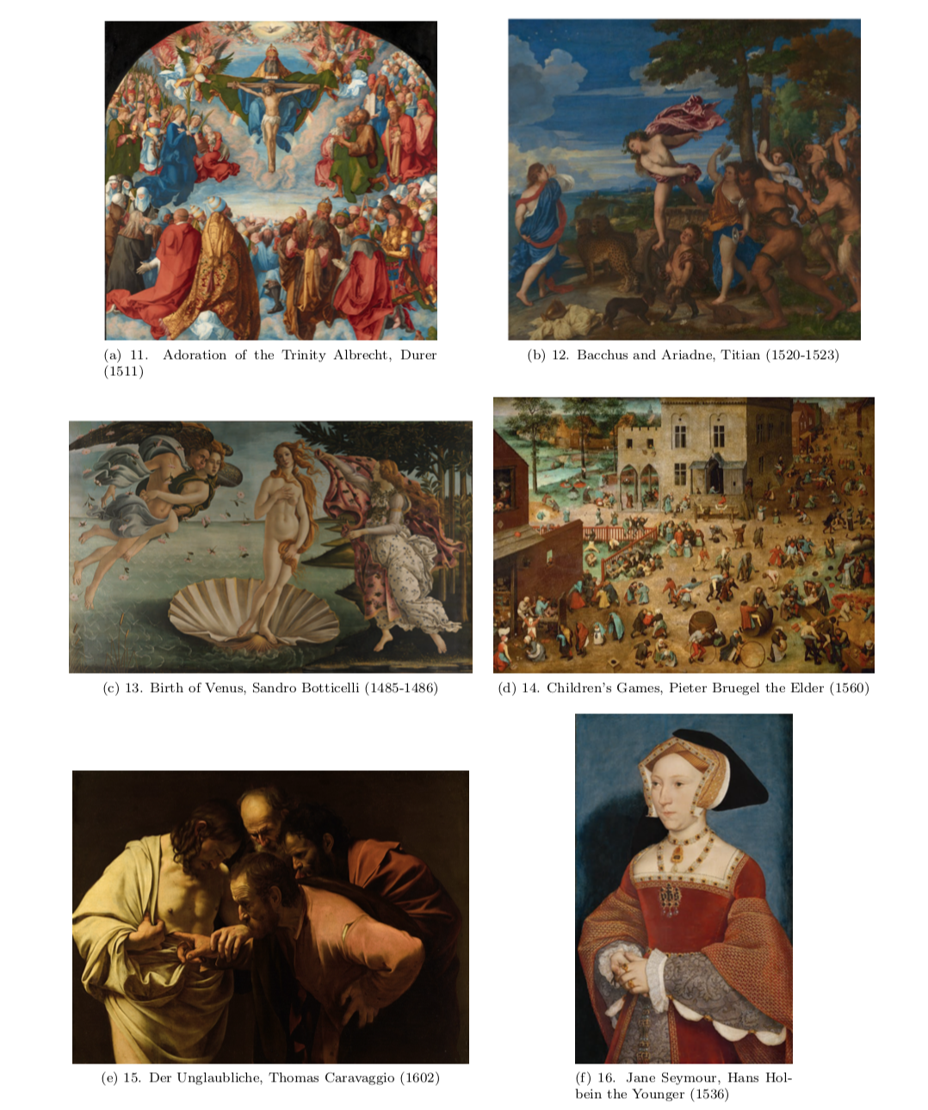
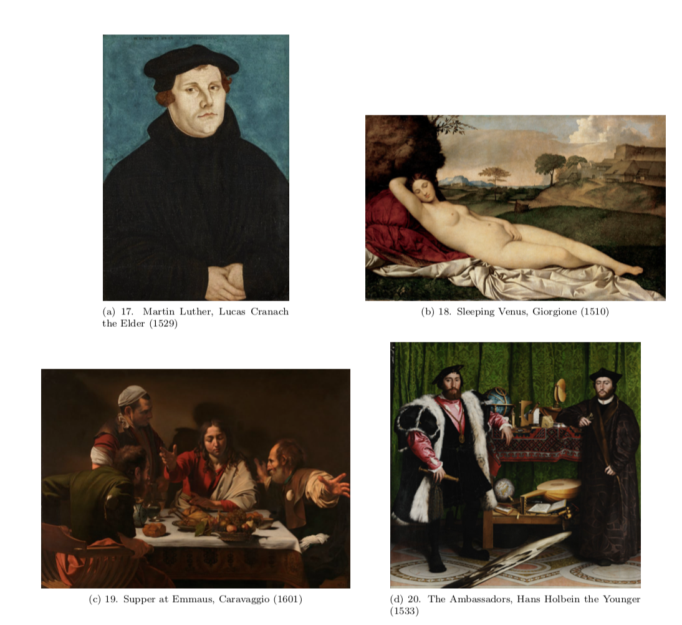
Renaissance Paintings

Slide 5
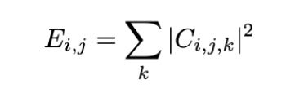
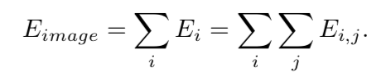
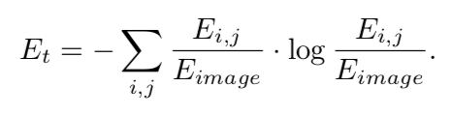
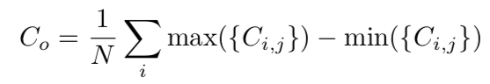

Preprocessing
Color: transformed RGB to HSV (Hue, Saturation, Value)
Color moments (mean and variance) taken as color distribution summary statistics
Texture: Wavelet transform
Energy =
Shannon Entropy =
Contrast =
Notes:
Explain why using HSV instead of RGB - good for when images span many different color palettes. and wavelet transform basic idea of getting textural info, can be used for many more feature extraction goals (edge detection, etc) (used for image compression and other image analysis)

Slide 6
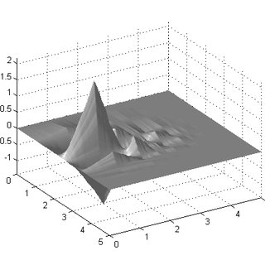
2D Discrete Wavelet Transform
Transform color image to grayscale and transform 2D pixel values to frequency domain (rate of change of pixel values over the spatial domain)
Applies series of low (isolates low frequency components) and high (isolates high frequency components) pass filters hierarchically to a grayscale image
Results in set of 4 subbands that are 4 different approximations of the image across horizontal, vertical, diagonal directions.
Filters iteratively applied to each resulting approximation image to build many layers of the subbands at different resolutions
Notes:
The process begins by applying a series of filters hierarchically to the (greyscale) image. A low-pass filter is first applied to the image, which preserves the low-frequency components of the image and removes the high-frequency components. This results in a set of subbands (or different approximations of the image), each containing a portion of the image but at a lower resolution. We get 4 resulting subbands for the filter applied across the image vertically (LH), horizontally (HL), diagonally (HH), and a residual subband that contains the remaining low-frequency information (LL). Next, a high-pass filter is applied to the original image which does the reverse, also resulting in 4 subbands [9].

Slide 7
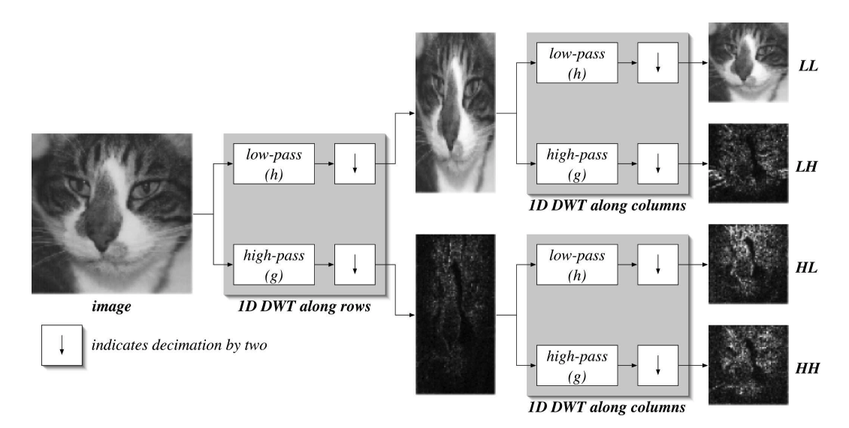

Slide 8
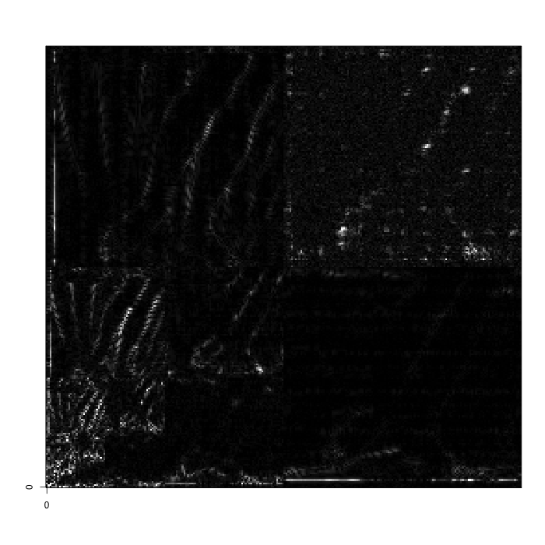
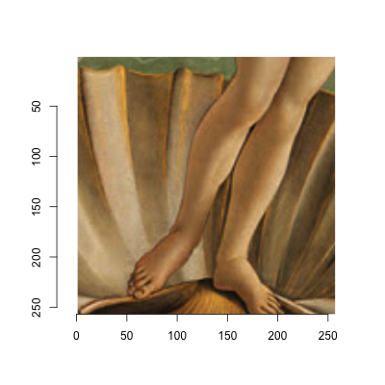

Slide 9
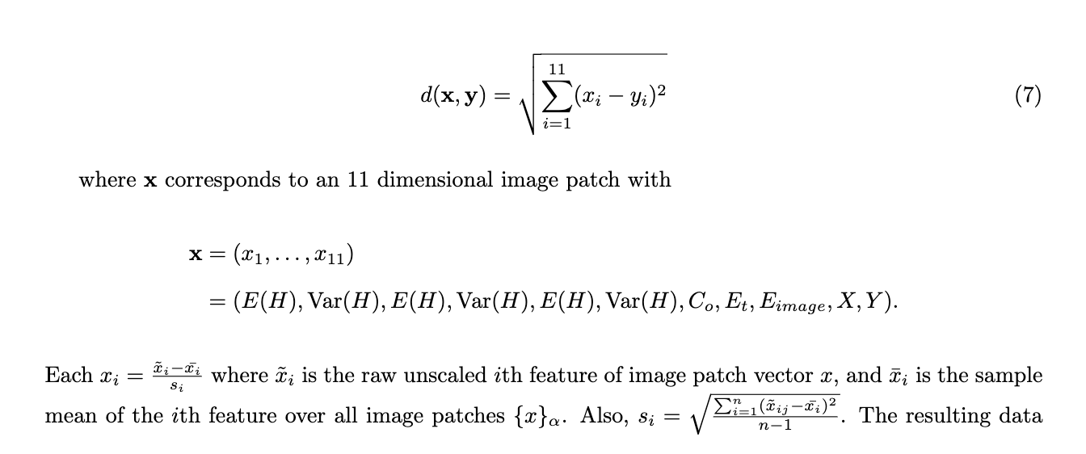
Distance Metric
Euclidean!

Slide 10
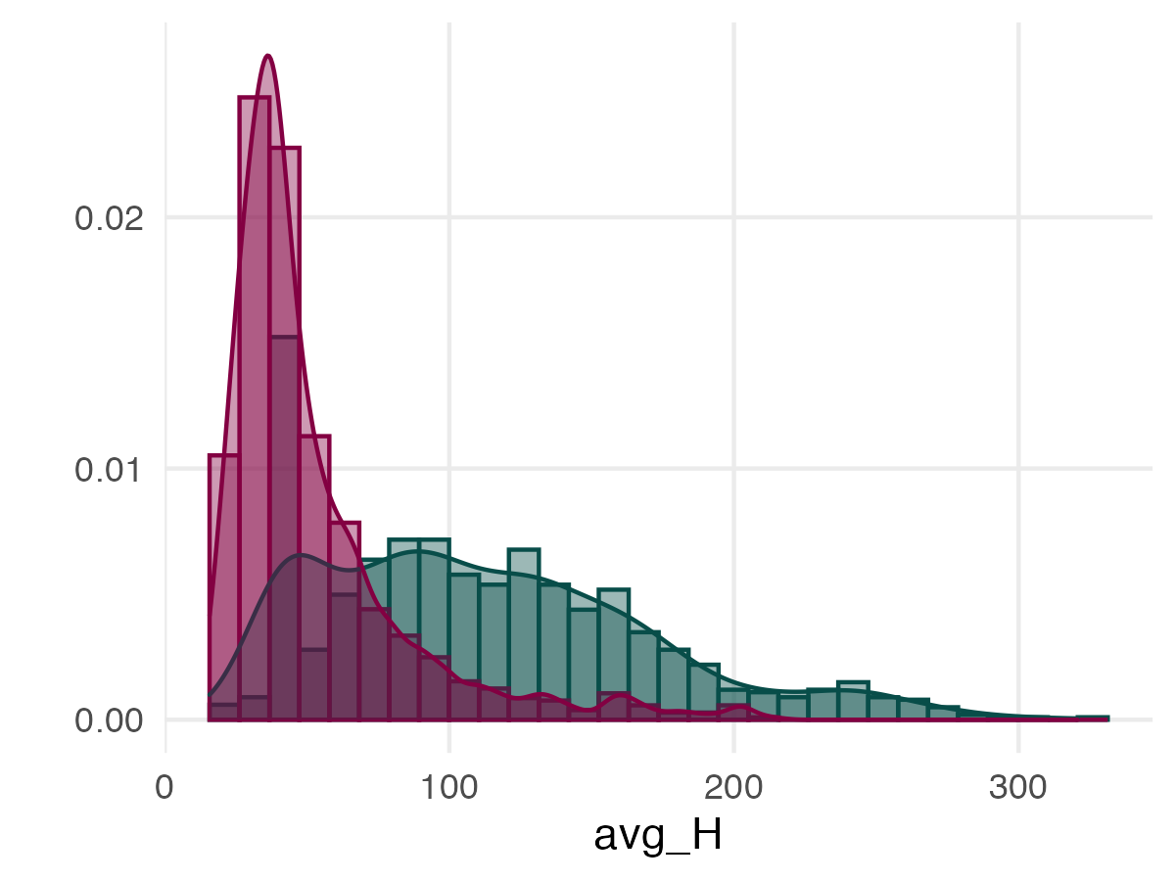
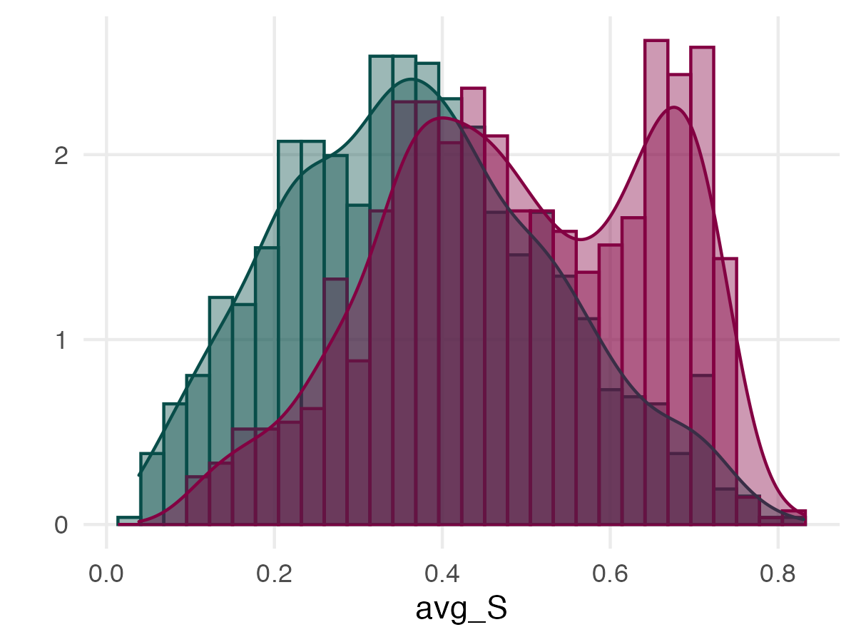
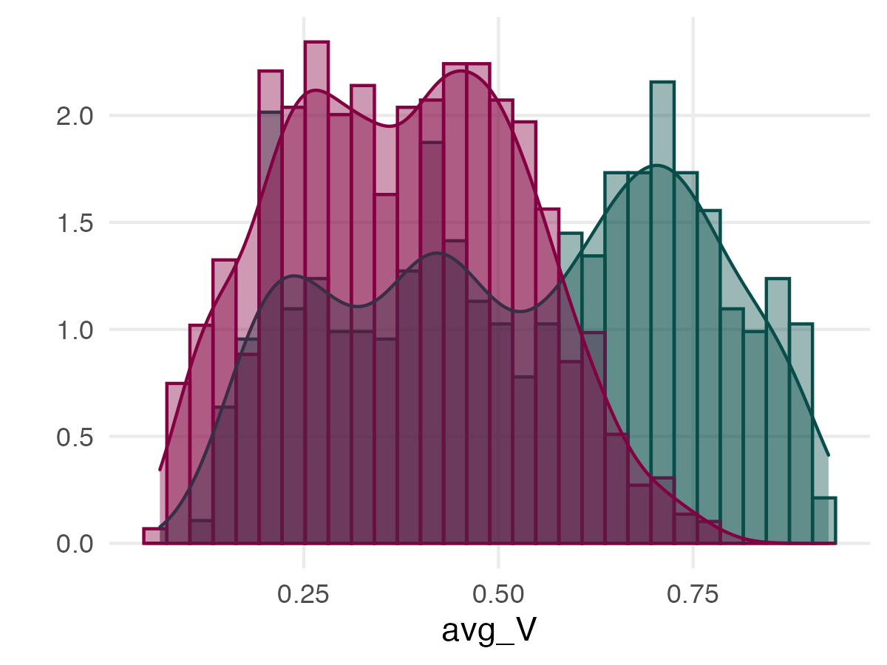
Initial Data Glimpse
Between movements
Renaissance artwork tends to be more saturated, darker in value, and the modal hue is a shade of red
Cubism tends to have higher variance across the features measure except entropy and average saturation
Notes:
Is there evidence for a difference in distributions simply from looking at the features we extracted? The differences seen here may shed light on later topological invariants

Slide 11
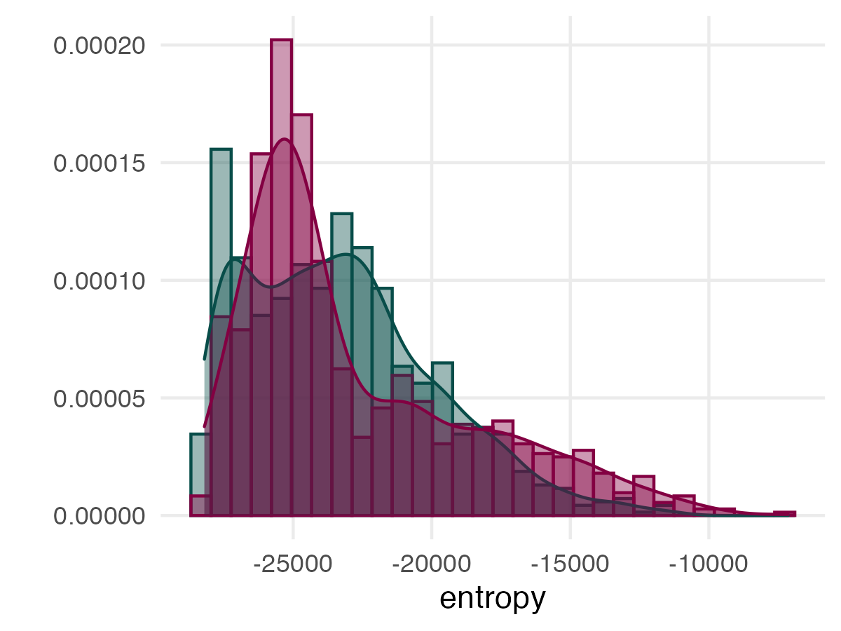
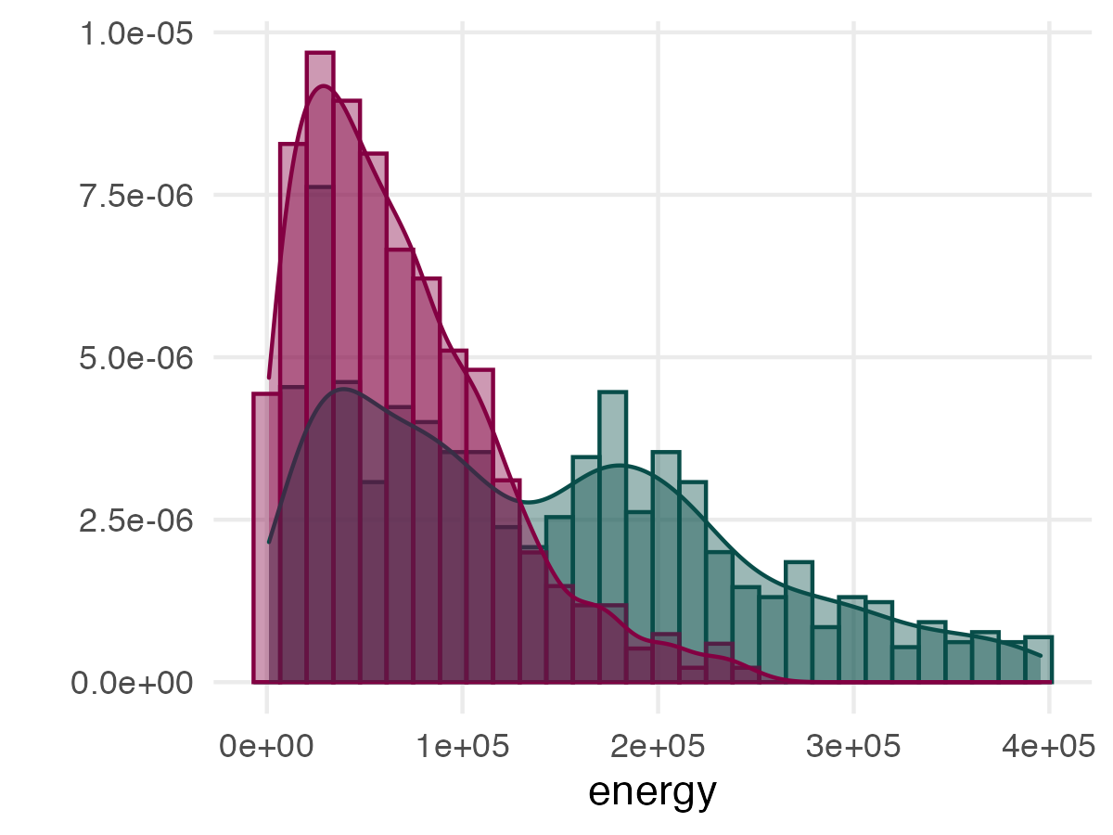
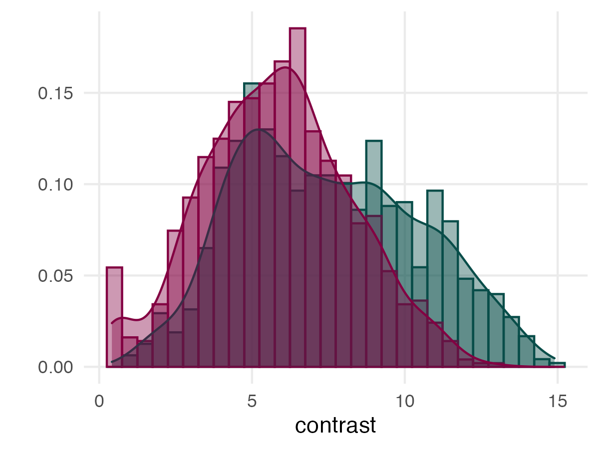

Slide 12
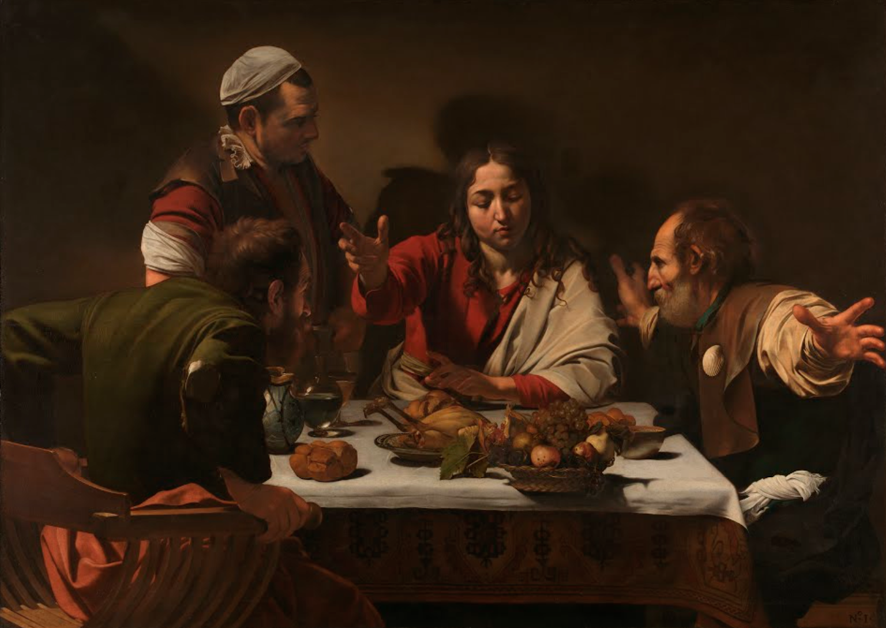
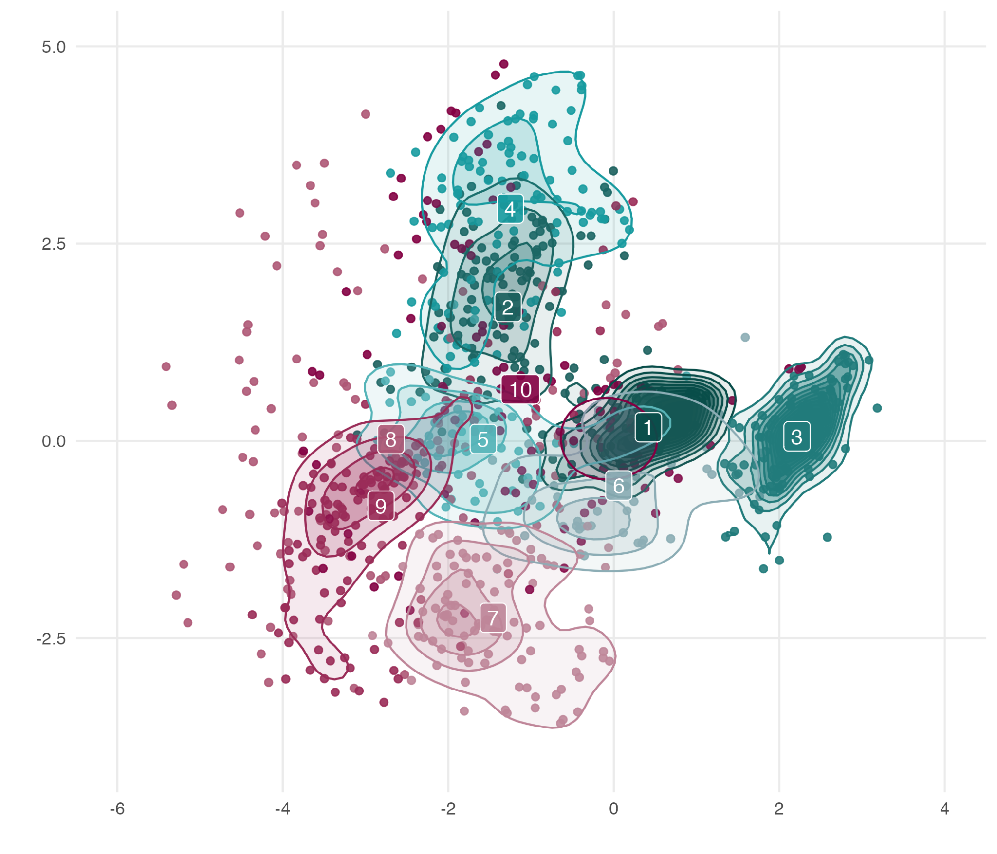
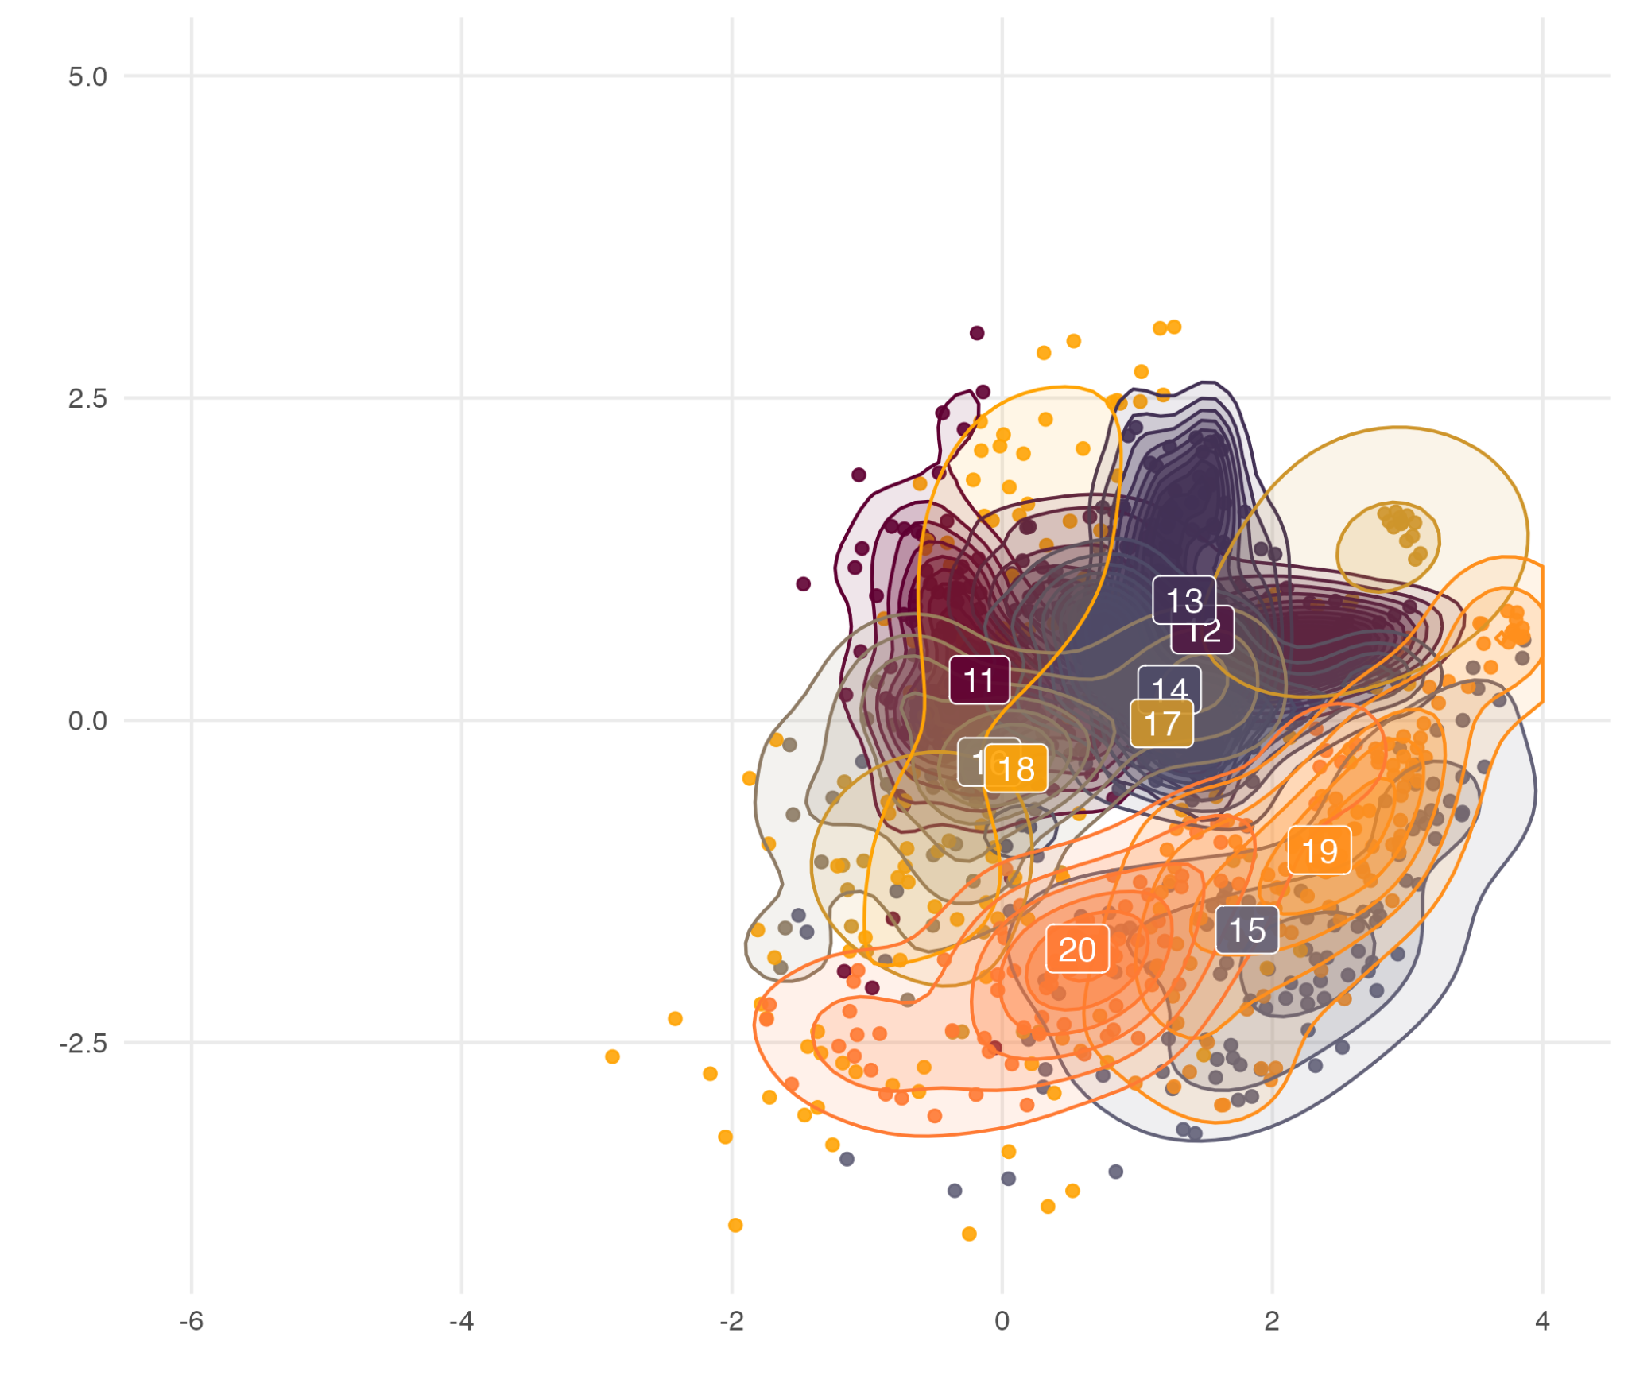
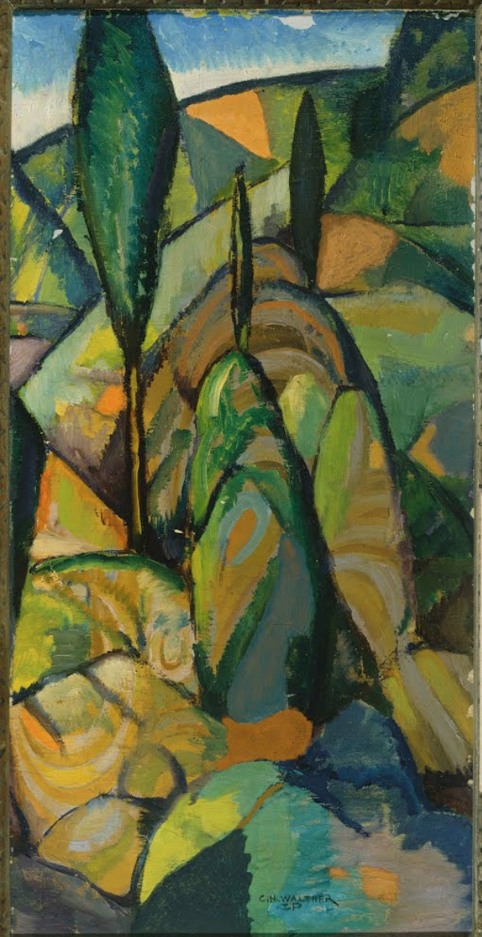
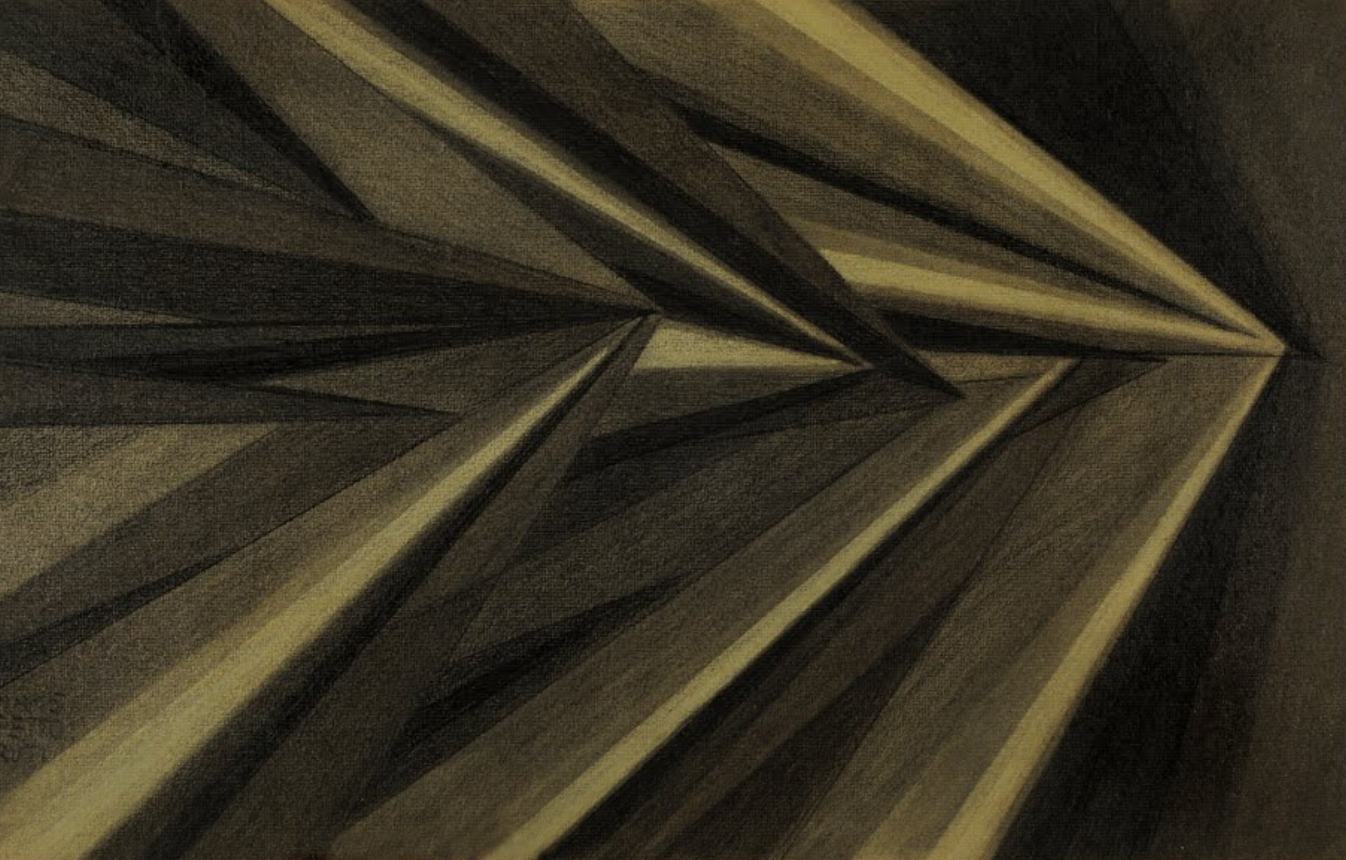
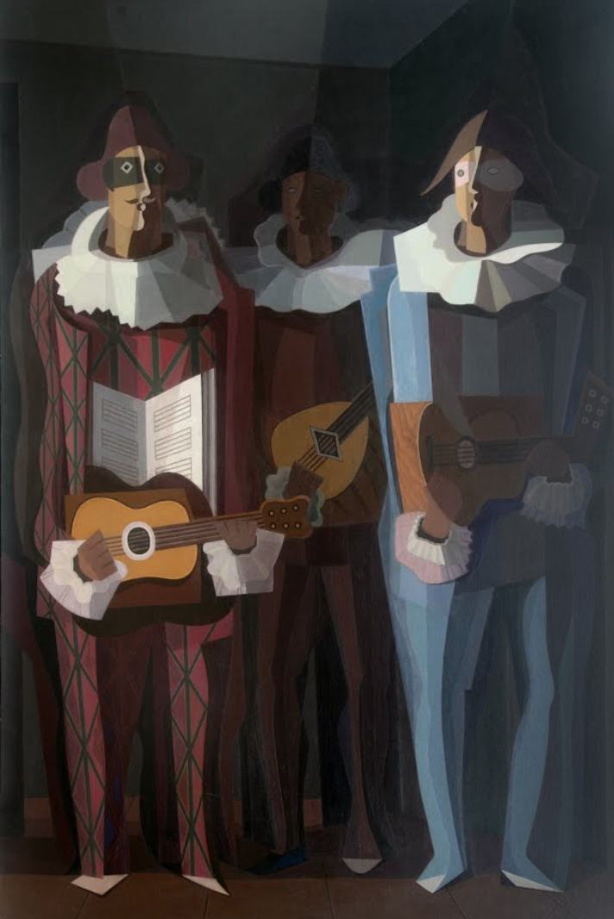
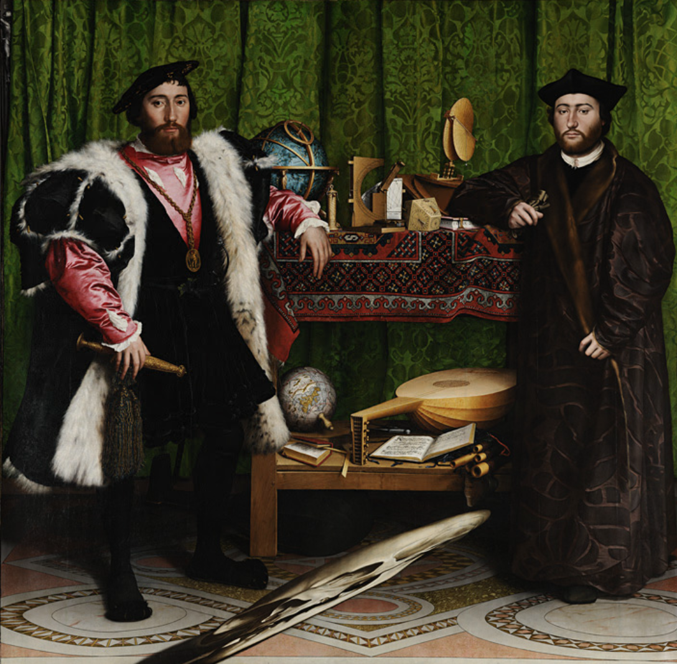
Within movements

Slide 13
Painting-level TDA
Computed 20 Vietoris-Rips filtrations for each painting
Example shown here are of portraits from both movements
Renaissance paintings Martin Luther and Jane Seymour similar along H0 and H1 homologies
Cubist portrait has fewer connected component persistence (but small gap between second to last connected component like the Renaissance portrait)
Air, Iron, and Water painting lacks H0 structure of the portraits
The two Cubist paintings and two Renaissance more similar to one another than the three portraits
Notes:
From these diagrams we can see that between the two Renaissance portraits (a) and (b), the H0 homologies in purple are similar, except there is slightly more persistence in topological features just below 2 on the death axis in Martin Luther than in Jane Seymour. However, both appear to have a similar small gap midway between 2 and 3 which perhaps corresponds to components of the head of the portrait and the clothing (see Figure 11). In H1 a similar very persistent cycle emerges between times 2 and 3 and with death time between 3.5 and 4, nonexistent in the Cubist images below.

Slide 14
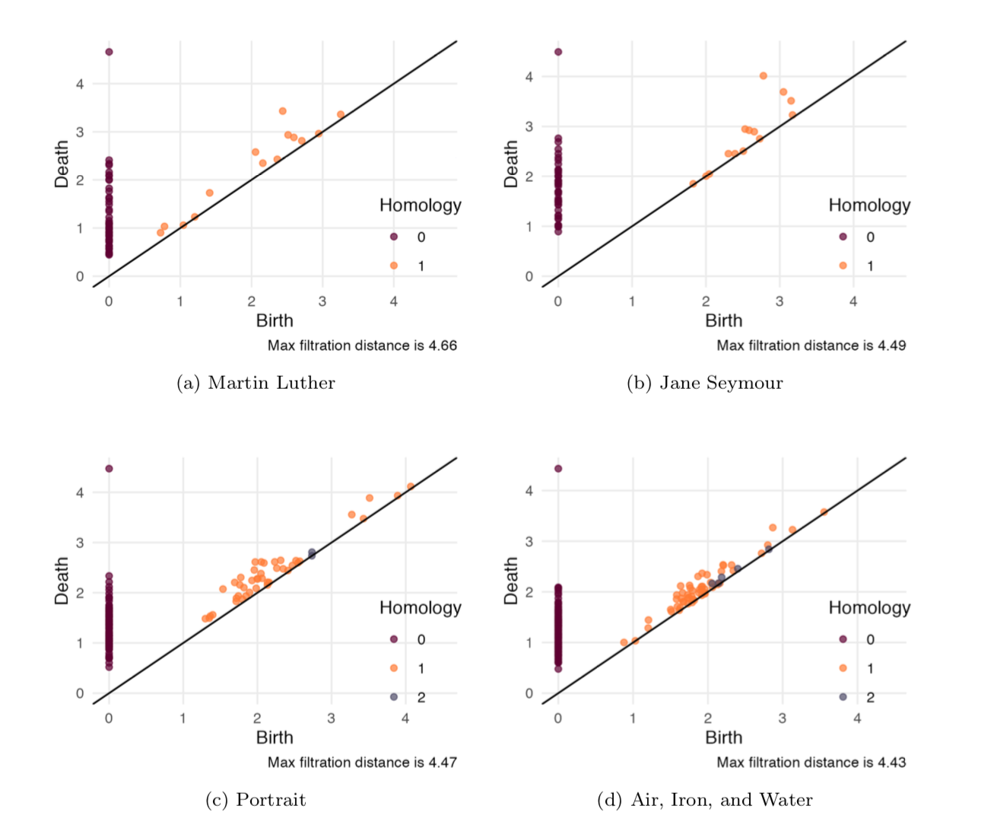
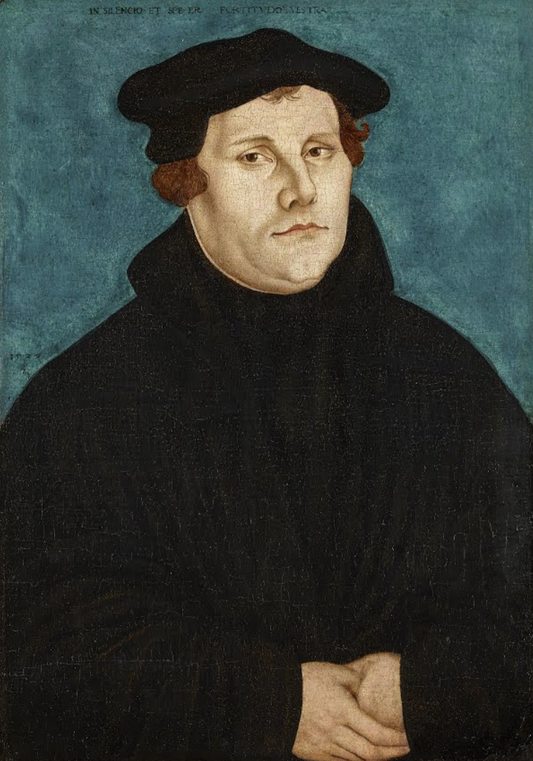
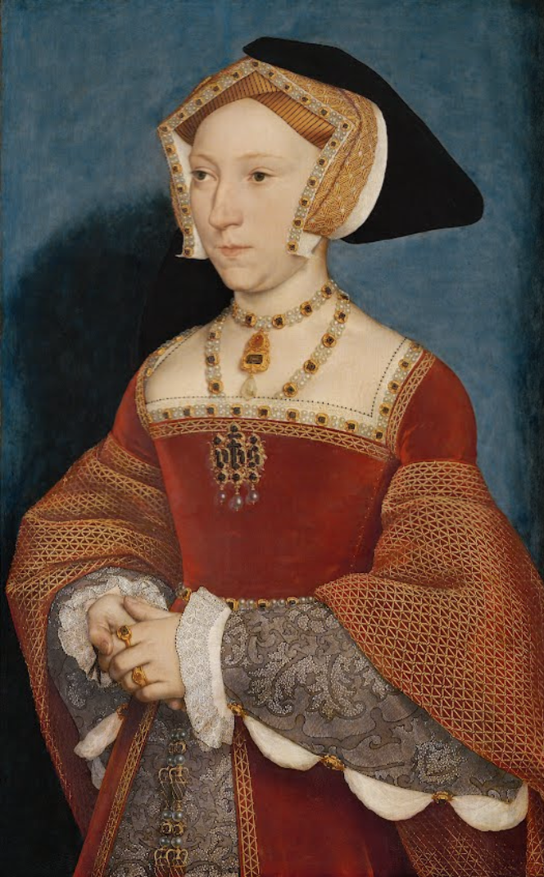
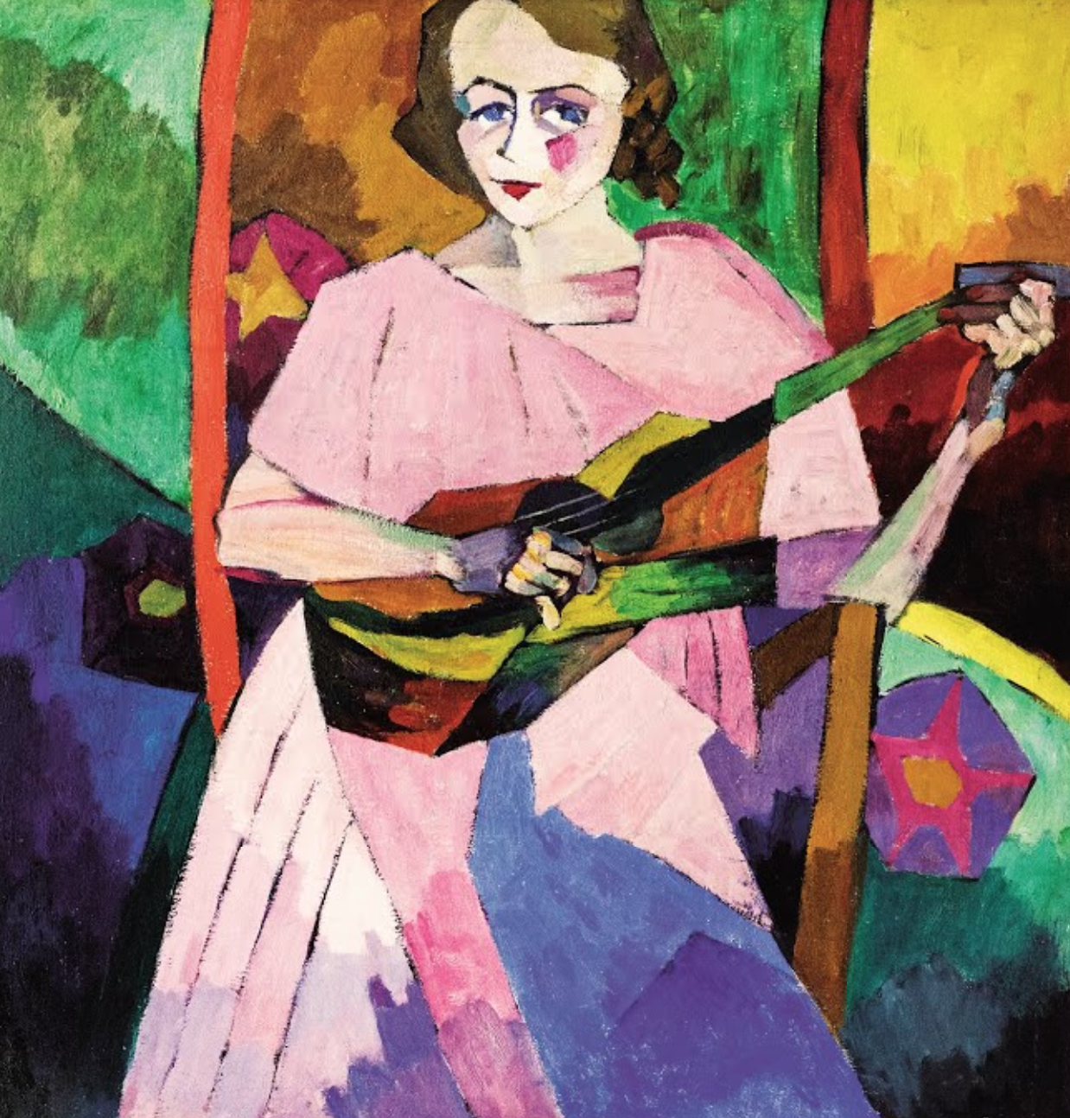
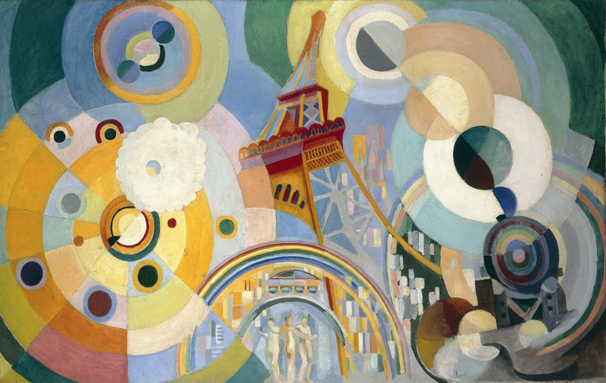

Slide 15
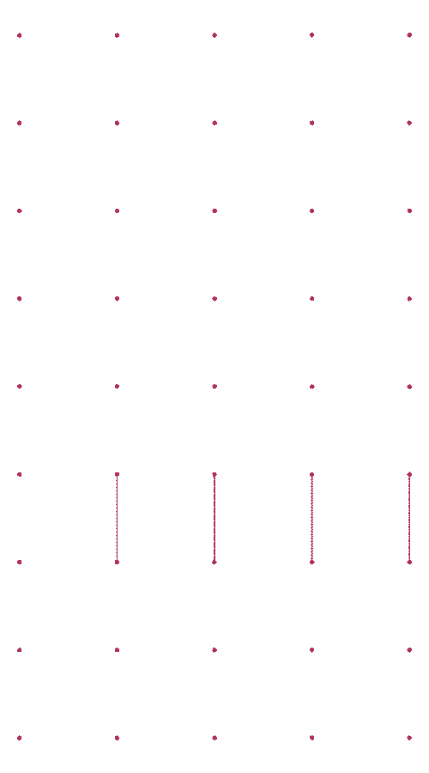
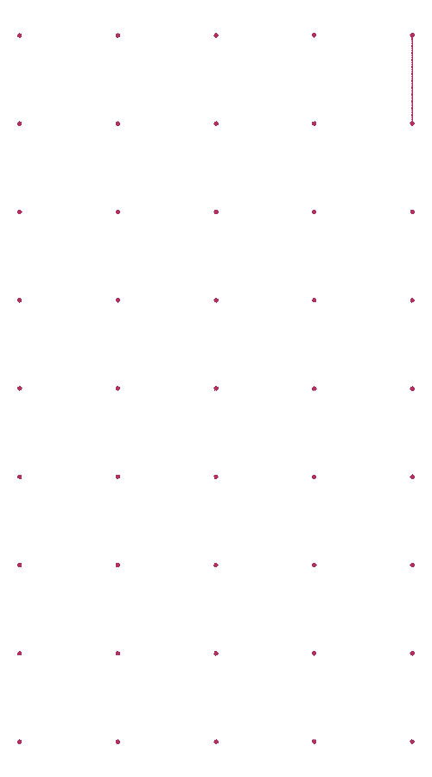
Notes:
Closer look into H0 homologies forming

Slide 16
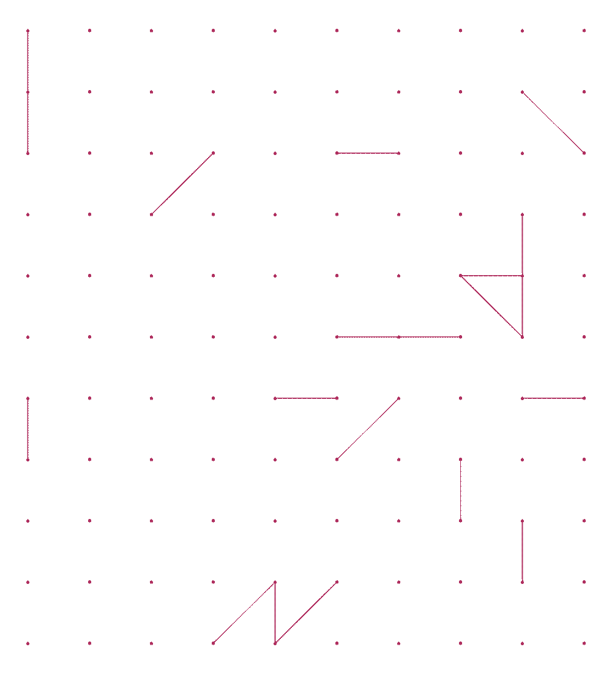

Slide 17
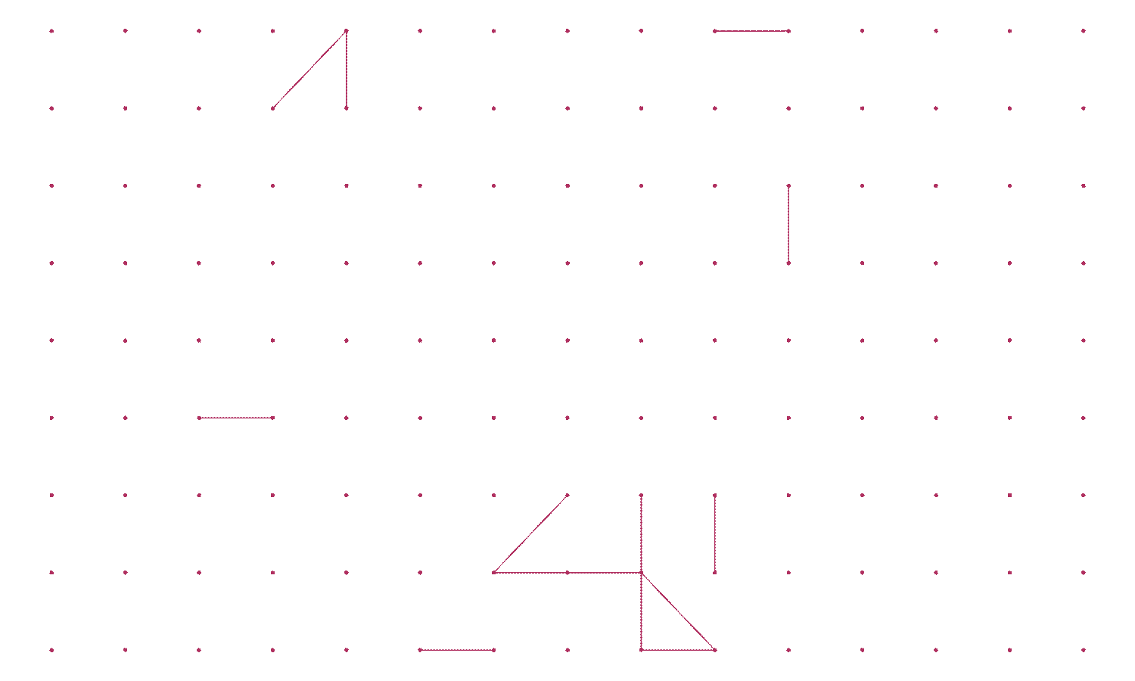

Slide 18
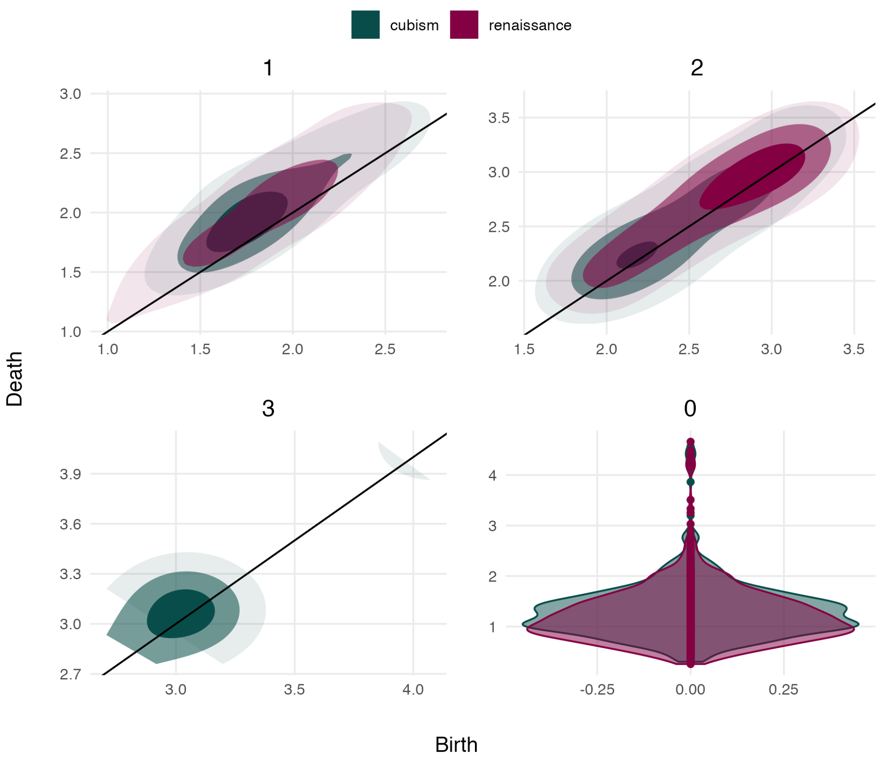
Notes:
2d overlaid density between homologies between the two movements aggregating all 20 separate filtrations into single persistence diagram. Overall distributions very similar, but subtle differences. H3 emerges only in a select few cubist works that are very different from the rest

Slide 19
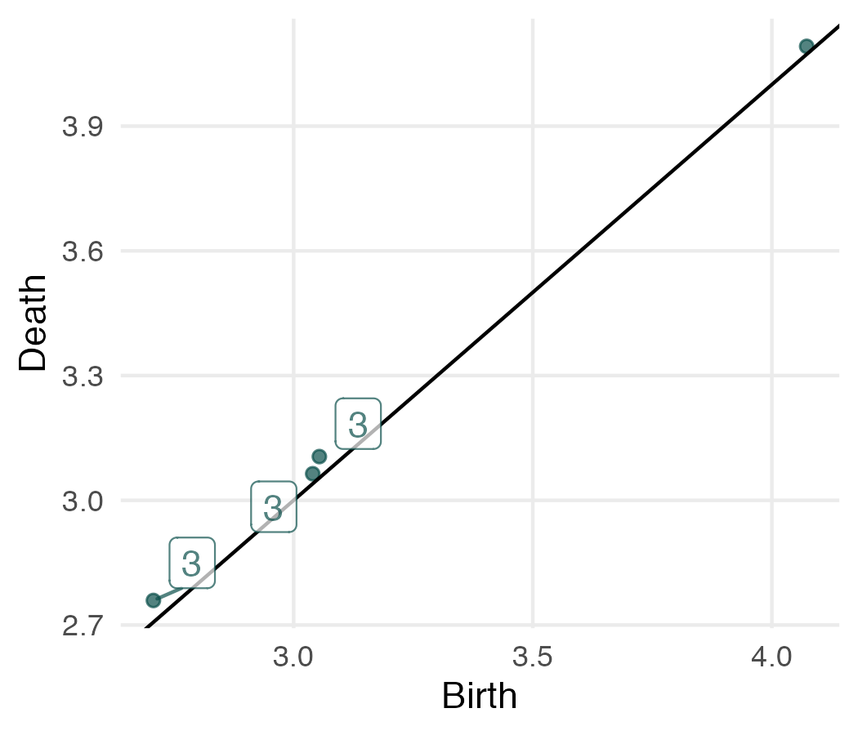
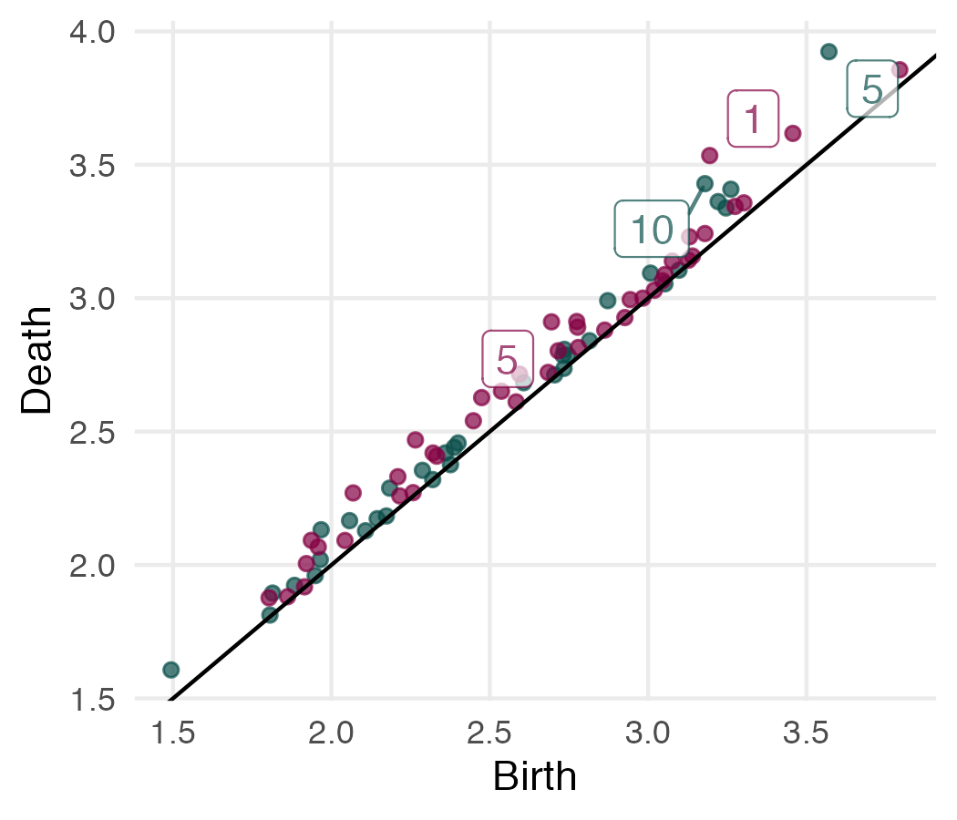
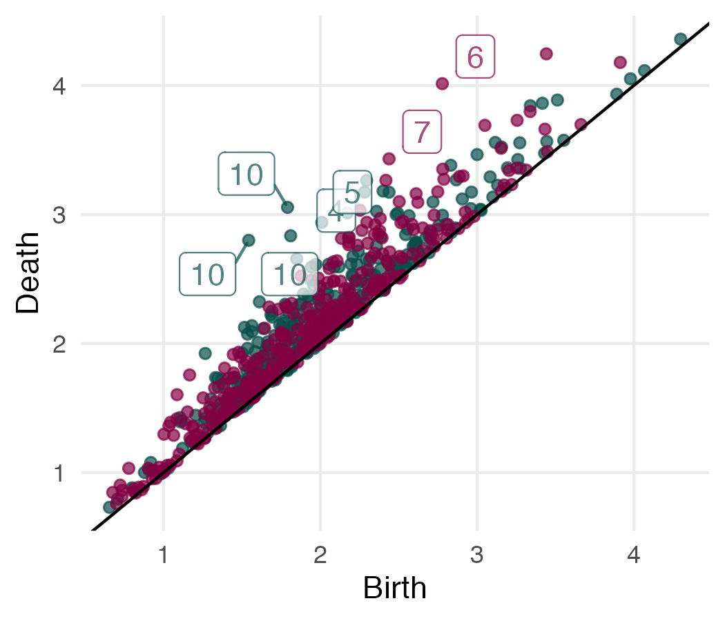
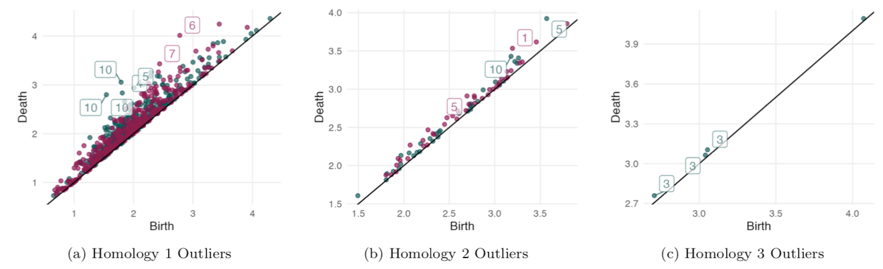
Most persistent features

Slide 20
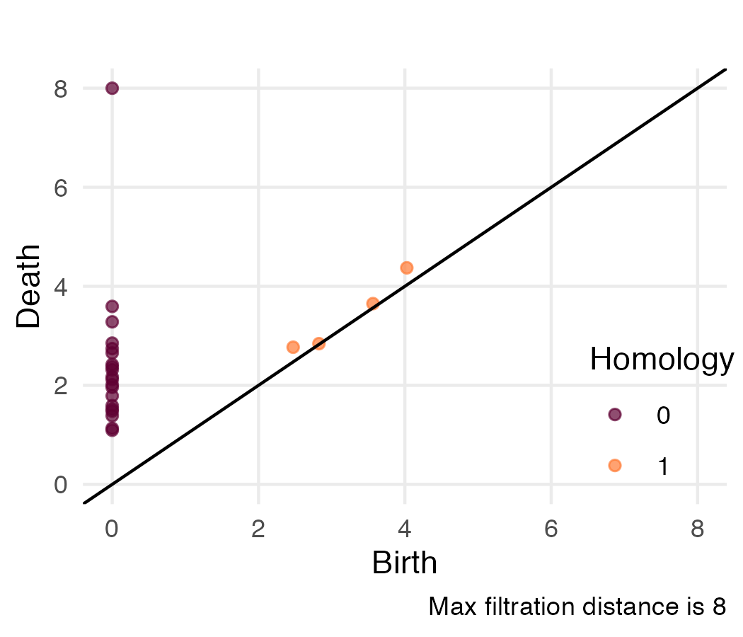
Movement-level TDA
2nd dataset constructed from centermost patches of 20 observations
Location information removed, Euclidean distance metric computed from remaining features
H0 did not split cleanly along movement lines
Higher homologies less informative as more data was needed, no persistent H1 cycles

Slide 21
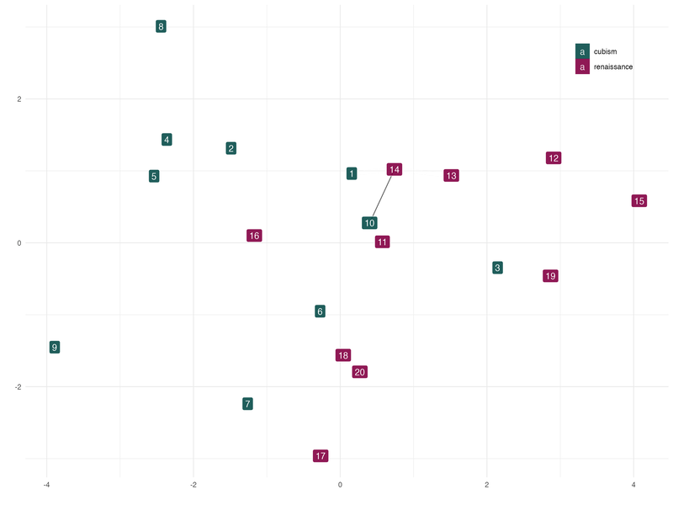
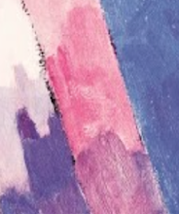
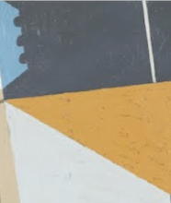
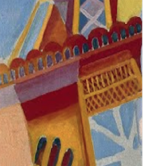
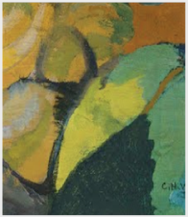
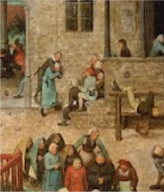
















Slide 22
Future Directions
Leverage wavelet coefficients themselves to assemble dataset and compute filtrations
Incorporate homologies into ML models that classify paintings into movements
Expand dataset to include more artworks within Cubism and Renaissance (maybe get more out of the movement-level analysis) and a wider range of movements

Slide 23
Thanks!

